Slide 1
L02.02 Heap
50.004 Introduction to Algorithm
Dr. Simon LUI
ISTD, SUTD

Slide 2
Revision – master theorem

Slide 3
Master theorem
So, a=2, b=2, f(n) = logn
Let’s check master theorem rule 1:
f(n) = logn, which is O(n^{log22-ɛ})=O(n^{1-ɛ}), so rule 1 is true
so, T(n) = Θ(n^{log22}) = Θ(n)
Let’s check master theorem rule 2:
f(n) = logn, which is not Θ(n^{log22})=Θ(n), so rule 2 is wrong
Let’s check master theorem rule 3:
f(n) = logn, which is not Ω(n^{log22+ɛ})=Ω(n^{1+ɛ}), so rule 3 is wrong

Slide 4
Master theorem
So, a=2, b=2, f(n) = n
Let’s check master theorem rule 1:
f(n) = n, which is not O(n^{log22-ɛ})=O(n^{1-ɛ}), so rule 1 is wrong
Let’s check master theorem rule 2:
f(n) = n, which is Θ(n^{log22})=Θ(n), so rule 1 is wrong
So, T(n) = Θ(n^{log22}logn) = Θ(nlogn)
Let’s check master theorem rule 3:
f(n) = n, which is not Ω(n^{log22+ɛ})=Ω(n^{1+ɛ}), so rule 1 is wrong

Slide 5
Master theorem
So, a=2, b=2, f(n) = n²
Let’s check master theorem rule 1:
f(n) = n², which is not O(n^{log22-ɛ})=O(n^{1-ɛ}), so rule 1 is wrong
Let’s check master theorem rule 2:
f(n) = n², which is not Θ(n^{log22})=Θ(n), so rule 2 is wrong
Let’s check master theorem rule 3:
f(n) = n², which is Ω(n^{log22+ɛ})=Ω(n^{1+ɛ}), so rule 3 is true
So, T(n) = Θ(f(n)) = Θ(n²)

Slide 6
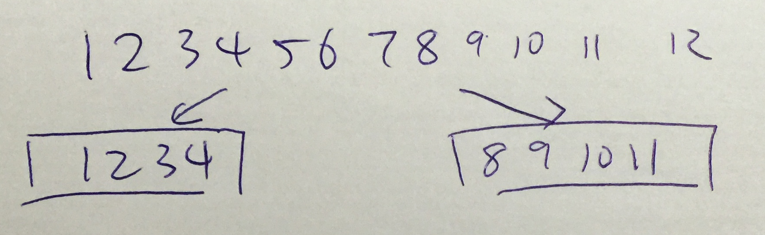
Meaning of a, b, f(n)
a means how many segments are divided
n/b means the number of elements in the sub-segment
e.g.
It may look like this
n=12
Divided into 2 segments
each segment has n/3 = 4 elements

Slide 7
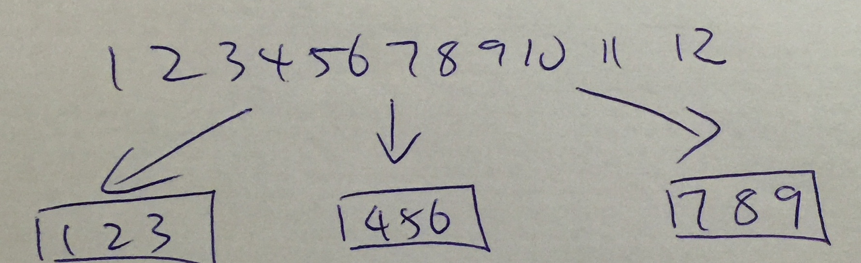
Meaning of a, b, f(n)
a means how many segments are divided
n/b means the number of elements in the sub-segment
e.g.
It may look like this
n=12
Divided into 3 segments
each segment has n/4 = 3 elements

Slide 8
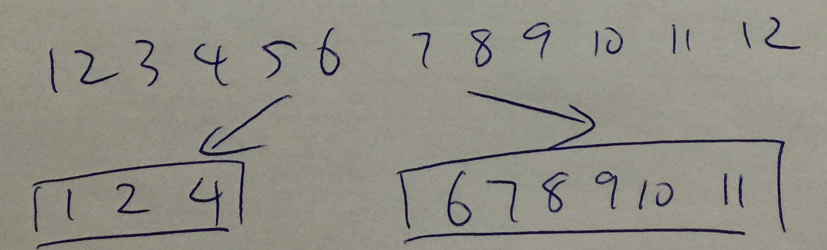
Meaning of a, b, f(n)
a means how many segments are divided
n/b means the number of elements in the sub-segment
e.g.
It may look like this
n=12
Divided into 1 segment of n/4 elements, and 1 segment of n/2 elements

Slide 9
Meaning of a, b, f(n)
a means how many segments are divided
n/b means the number of elements in the sub-segment
So, T(n) only tell us the running time of the algorithm
T(n) doesn’t care the elements value
(e.g. if a=2, b=2, it can split [1,2,3,4] into [1,2][3,4] or [1,3][2,4] or [1,1][2,2]… etc)
(e.g. if a=2, b=4/3, it can split [1,2,3,4] into [1,2,3][1,2,4] or [1,2,4][2,2,2]… etc)
… the values depends on your algorithm
- Values in sub-segments can overlap
- You can withdraw any elements too

Slide 10
Heap

Slide 11
Objective
Motivate the heap data structure
How the heap works
Heap-related algorithms

Slide 12
Priority queue
“Priority queue” = abstract data type (ADT) implementing a set S of elements (each associated with a key) supporting the following operations
k(x) = key of element x
max(S) : return element from S with largest key
insert(S,x) : insert element x into set S
extract_max(S) : return element from S with largest key and remove it from S
increase_key(S,x,k’): increase the value of element x’s key k(x) to new value k’
Notes:
in order sorting

Slide 13
Complexity
If we use an array to store the elements
Start with an empty S
Keep the element in S as follow:
(Array i) in the order they arrive
(Array ii) sort S in decreasing order, right after any new element is inserted
operation | Array i | Array ii
max(S) | Θ(n) | Θ(1)
insert(S,x) | Θ(1) | Θ(n)
extract_max(S) | Θ(n) | Θ(n)
increase_key(S,x,k) | Θ(n) | Θ(n)

Slide 14
Complexity
… and this is heap
operation | complexity (i) | complexity (ii) | Heap
max(S) | Θ(n) | Θ(1) | Θ(1)
insert(S,x) | Θ(1) | Θ(n) | Θ(logn)
extract_max(S) | Θ(n) | Θ(n) | Θ(logn)
increase_key(S,x,k) | Θ(n) | Θ(n) | Θ(logn)

Slide 15
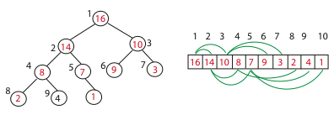

Heap
Implementation of a priority queue
Heap = an array visualized as a nearly complete binary tree
It is an array, but can be used as tree
Max (Min) Heap Property: the key of a node is ≥ (≤) than the keys of its children
Notes:
Is heap array sorted?

Slide 16
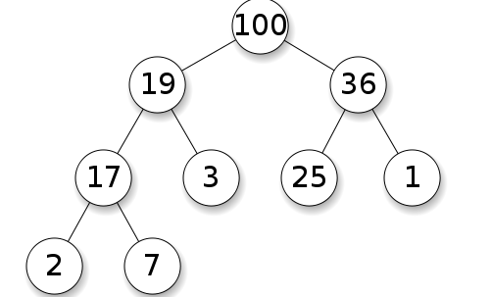
Max heap

Slide 17
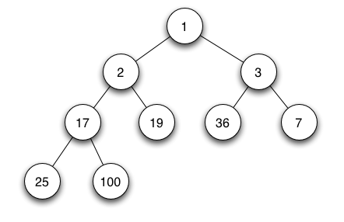
Min heap

Slide 18
Heap = visualizing an array as a tree
root of tree:
first element in the array, corresponding to index i = 1
If a node’s index is i then:
returns index of node's parent, e.g. parent(5)=2
left(i) = 2i;
returns index of node's left child, e.g. left(4)=8
right(i) = 2i+1;
returns index of node's right child, e.g. right(4)=9
No pointers needed!

Slide 19
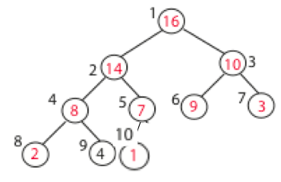
Basic property of a heap
No pointers required to implement a tree!
Height of a binary heap O(log n)
0
h=3
1
2
_
_
3

Slide 20
Operations with Heaps
build_max_heap :
produce a max-heap from an unordered array. Complexity: O(n)
max_heapify :
correct a single violation of the heap property occurring at the root of a sub-tree. Complexity: O(log n)
insert, extract_max :
Complexity: O(log n)
heapsort :
sort an array of size n using heap.
Complexity: O(n log n)

Slide 21
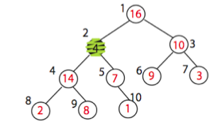
Exercise: think of an algorithm to correct the inconsistency
in node 2
What is the complexity?

Slide 22
Max_heapify
correct a single violation of the heap property occurring at the root of a subtree in O(log n)
Assume that the trees rooted at left(i) and right(i) are max-heaps, but element A[i] violates the max-heap property;
i.e. A[i] is smaller than at least one of A[left(i)] or A[right(i)].
The goal is to correct the violation.
Do this by trickling element A[i] down the tree, making the subtree rooted at index i a max-heap.

Slide 23
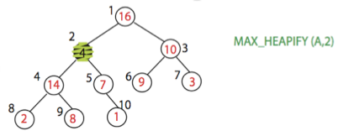
Max_heapify (Example)

Slide 24
Max_heapify (Pseudocode)
Max_heapify (A, i)
Find the index of the largest element among A[i], A[left(i)] and A[right(i)]
If this index is different than i, exchange A[i] with largest element; then recurse on subtree

Slide 25
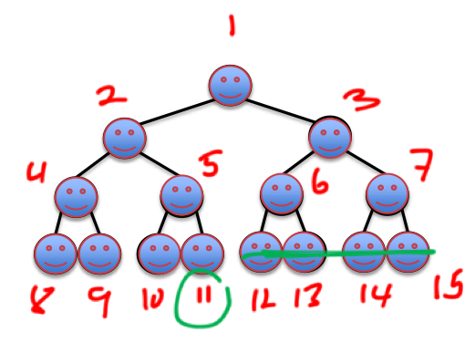
Build_Max_Heap(A)
Convert A[1…n] to a max heap
Observation: Elements are leaves of the tree
because 2i > n, for all
(if 2i > n, then node i has no left child. So it must be a leave)
so heap property may only be violated at nodes 1… of the tree

Slide 26
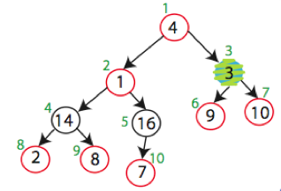
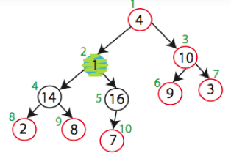
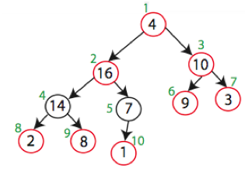
Build_Max_Heap (Example execution)

Slide 27
Complexity of Build_Max_Heap?
An Obvious upper bound for Build_Max_Heap: O(nlogn)
- Heapify for O(n) times
- Each heapify = O(logn)

Slide 28
Recall a naïve algorithm for sorting an array
Sorting Strategy:
Find largest element of array, place it in last position; then find the largest among the remaining elements, and place it next to the largest, etc…
In notation:
1. last_el = n;
Θ(n)
2. Find maximum element A[i] of array A[1…last_el];
Θ(n²)
3. Swap A[i] and A[last_el];
2
6
2
3
8
9
5
1
7
4
4. last_el = last_el - 1;
2
6
2
3
8
4
5
1
7
9
5. Go to step 2
2
6
2
3
7
4
5
1
8
9
Now, we have a fast data structure for step 2! (which is also the most costly)
Let’s implement the array as a heap
…

Slide 29
Heap-Sort
Sorting Strategy:
1. Build a Max Heap from an unordered array;

Slide 30
Heap-Sort

Slide 31
Heap-Sort
Sorting Strategy:
1. Build a Max Heap from unordered array;
2. Find the maximum element: A[1];
3. Swap elements A[n] and A[1]:
now the max element is at the end of the array!

Slide 32
Heap-Sort
Swap elements A[10] and A[1]

Slide 33
Heap-Sort
Sorting Strategy:
1. Build Max Heap from unordered array;
2. Find maximum element A[1];
3. Swap elements A[n] and A[1]:
now max element is at the end of the array!
4. Discard node n from the heap
(by decrementing heap-size variable)

Slide 34
Heap-Sort
Swap elements A[10] and A[1]
heap_size = heap_size-1

Slide 35
Heap-Sort
Sorting Strategy:
1. Build Max Heap from unordered array;
2. Find maximum element A[1];
3. Swap elements A[n] and A[1]:
now max element is at the end of the array!
4. Discard node n from heap
(by decrementing heap-size variable)
5. New root may violate max heap property, but its children are max heaps. Run max_heapify to fix this.

Slide 36
Heap-Sort

Slide 37
Heap-Sort
Sorting Strategy:
1. Build Max Heap from unordered array;
2. Find maximum element A[1];
3. Swap elements A[n] and A[1]:
now max element is at the end of the array!
4. Discard node n from heap
(by decrementing heap-size variable)
5. New root may violate max heap property, but its children are max heaps. Run max_heapify to fix this.
6. Go to step 2.

Slide 38
Heap-Sort
Swap elements A[9] and A[1]

Slide 39
Heap-Sort
Max_Heapify(A,1)

Slide 40
Heap-Sort
Swap elements A[8] and A[1]

Slide 41
and so on…

Slide 42
Heap-Sort
Running time:
after n iterations the Heap is empty
every iteration involves a swap and a heapify operation; hence it takes O(log n) time
Overall O(n log n)

Slide 43
Operations with Heaps
build_max_heap :
produce a max-heap from an unordered array in O(n);
max_heapify :
correct a single violation of the heap property occurring at the root of a subtree in O(log n);
insert, extract_max, increase_key : O(log n)
heapsort :
sort an array of size n in O(n log n) using heaps

Slide 44
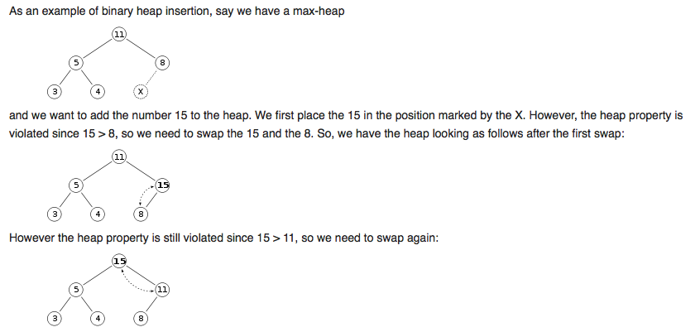
Insert
So it takes O(logn)

Slide 45
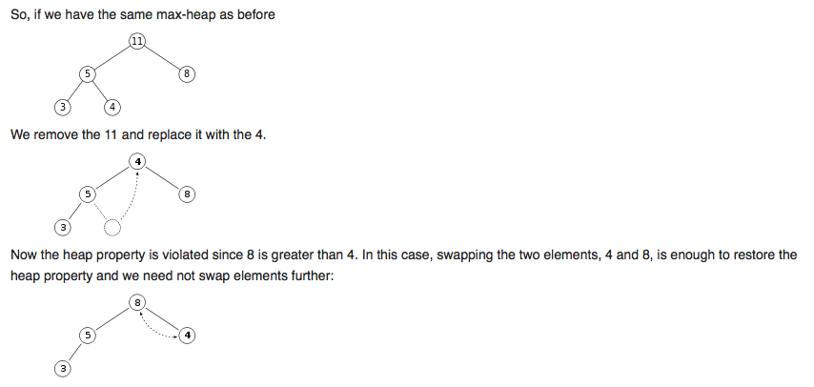
Extract max
So it takes O(logn)

Slide 46
Increase key
Very simple…
Start from the bottom, search up the tree
Found the key, increase its value
So it takes O(logn)

